Slide 1
Introducing Silverlight 4.0
<Presenter Name=“Rudi Grobler”>
<Presenter.ContactDetails>
<Company Source=“Barone, Budge & Dominick” />
<Blog Source=“http://www.rudigrobler.net”/>
<Twitter Source=“@rudigrobler” />
<Email Source=“rudi@bbd.co.za” />
</Presenter.ContactDetails>
</Presenter>

Slide 2
A Brief History of Silverlight
MIX 07
Sep 07
MIX 08
Oct 08
Silverlight 1.0 Beta
Silverlight 1.1 Alpha
Silverlight 1.0
Silverlight 2 Beta
Silverlight 2
MIX 09
Jul 09
PDC 09
Spring 10
Silverlight 3 Beta
Silverlight 3
Silverlight 4 Beta
Silverlight 4

Slide 3
A Brief History of Silverlight
SEP 07
X-Browser
X-Platform
Designer / Developer Workflow
High Quality Audio/Video
Auto-Updater
Animation & Vector Graphics
Silverlight 1.0

Slide 4
A Brief History of Silverlight
OCT 08
High Performance Runtime
Flexible Data Access
Content Protection
Robust Networking
Role-Based Tools & DLR
Silverlight 2.0

Slide 5
A Brief History of Silverlight
JUL 09
Out of Browser
GPU Acceleration
Navigation & Validation
H.264 / AAC
Perspective Transforms & Pixel Shaders
Silverlight 3.0

Slide 6
A Brief History of Silverlight
MAR 10
Elevated Trust
Printing
Webcam / Mic
Rich Text & HTML Hosting
Input Improvements
Localized to 41 Languages
Silverlight 4.0 RC

Slide 7

What do YOU want?
Print support
Full databinding support
Implement right click mouse support (and popup menu customization)
Implement webcam support
Implement Silverlight on more platforms
Implement mouse wheel support for standard controls
Rich Text Editor & Textblock
Get Silverlight on the iPhone
Commanding Support
3D support

Slide 8
Silverlight 4 Beta
Out of Browser Applications
Elevated Privileges Support (including Automation)
HTML Hosting Support
Notifications
Media
WMS Multicast Support
MP4 Playback Protected by PlayReady DRM
Offline DRM
Output Protection
WebCam/Mic Support (raw stream only)
Text
RichTextBox
Arabic and Hebrew Text Support
IME Improvements for TextBox
UIElement.TextInput event
Controls, Control Model, Layout
Theming via Implicit Styles
ViewBox
RTL Layout
DataGrid * Column Support
ItemsControl support for Blend Fluid Layout
MouseWheel Support on ScrollViewer, TextBox, ComboBox,
Calendar, DatePicker
VisualStateGroup.CurrentStateGroup property
Command Property on ButtonBase & Hyperlink
SelectedValue and SelectedValuePath Properties on Selector
Navigation
Navigation Loader Extensibility (Hook Frame Navigates)
Databinding Improvements
DataBinding Support for DependencyObjects
StringFormat, TargetNullValue & FallBackValue Properties on Binding
Binding to String Indexers
IDataErrorInfo Support
Asynchronous Data Validation (INotifyDataErrorInfo)
ObservableCollection<T> IList/IEnumerable cstrs
Graphics/Imaging
Support for more PNG Formats
Unseal Path
CompositeTransform
Networking
UDP Listener
Automatically Adding Referer Header
Authentication Support on ClientHttpWebRequest
Memory Usage Fix During Progressive Downloads
Tools Support
Dispatcher Support on the Tools Design Surface
SDK
ADO.NET Data Services 2.0 Support
Managed Extensibility Framework (MEF)
Better Transport for WCF (Socket Support)
Printing
Printing Support

Slide 9
Silverlight 4 RC
RC
Parser
New architecture enables future innovation
Performance and stability improvements
XmlnsPrefix & XmlnsDefinition attributes
Support setting order-dependent properties
Input
Pinned full-screen mode on secondary display
HTML hosting accessibility
Arabic, Hebrew and Thai input on Mac
Rich Text
Text position and selection APIs
RichTextBox.Xaml property for serializing text content
XAML clipboard format
FlowDirection support on Runs
“Format then type” support
Thai & Vietnamese input support
UI Automation Text pattern
Out of Browser / Elevated Trust
XAP signing
Silent install and emulation mode
Custom window chrome
Better support for Automation
Cancelable shutdown event
Updated security dialogs
Sockets security restrictions removal
Media
Webcam/Mic configuration preview
More descriptive MediaSourceStream errors
Updates to H.264 content protection (ClearNAL)
Digital Constraint Token
CGMS-A
Graphics card driver validation & revocation
Graphics/Imaging
Hardware-accelerated Perspective Transforms
Ability to query page size and printable area
Memory usage and perf improvements
Data
Entity-level validation support of INotifyDataErrorInfo for DataGrid
XPath support for XML
SDK
System.Numerics.dll
System.Xml.XPath.dll
Dynamic XAP support (MEF)
Frame/Navigation refresh support
Networking
UploadProgress support (client stack)
Caching support (client stack)
Sockets policy file retrieval via HTTP
Accept-Language header

Slide 10
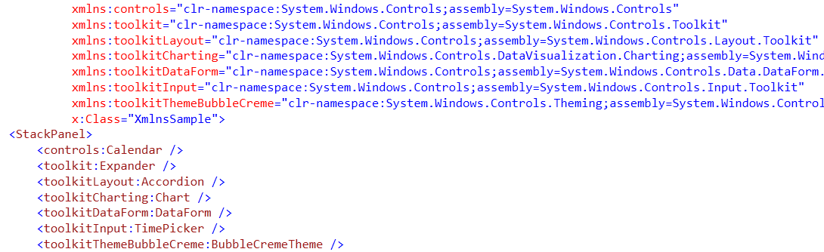
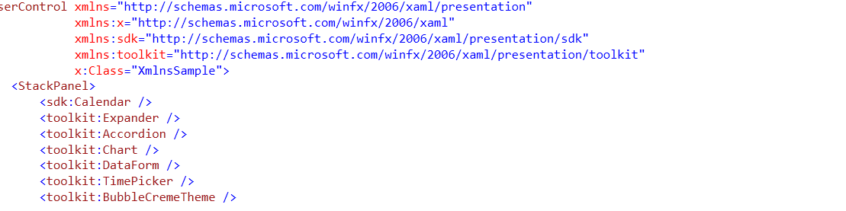
Parser
RC
New architecture enables future innovation
Performance and stability improvements
Support setting order-dependent properties
XmlnsPrefix & XmlnsDefinition attributes

Slide 11
Common Feature Requests
Dragging files into silverlight
Right click support
Printing support

Slide 12
Scrapbook Drag & Drop, Right-click & Printing
<demo/>

Slide 13
Printing
Customizable print layout
From live visual tree
From dynamic visual tree (Not on screen)
Bitmap based
Event model that supports pagination
Ability to query page size and printable area

Slide 14
Media
Multicast
Playback of multicast files from WMS
Offline DRM
Download to own, Rental, Subscription, License Predelivery, Support for Domains
MP4 DRM
Protect H264 and AAC-LC in the industry standard Mp4 file
Output protection
WebCam & Mic support

Slide 15

Open Sourcing the Olympics Player
smf.codeplex.com

Slide 16
Photobooth WebCam
<demo/>

Slide 17
WebCam
User prompt to use WebCams
Access to the raw video & audio streams
APIs to select between devices

Slide 18
Input
RC
Mouse wheel support
ScrollViewer, TextBox, ComboBox, Calendar, DatePicker
Pinned full-screen mode on secondary display
HTML Hosting accessibility
Arabic, Hebrew, Indic, Thai input and render

Slide 19
Silverlight Notepad
<demo/>

Slide 20
Rich Text RichTextArea RichTextBox
ReadOnly or Editable
Content Model
Runs, Spans & Paragraphs
Hyperlinks
Embedded Elements
Multi-level Undo
FlowDirection
Shaping Support
New Languages: Arabic & Hebrew

Slide 21
Rich Text RichTextArea RichTextBox
RC
Text position and selection APIs
“Xaml” property for serializing text content
XAML clipboard format
“Format then type” support
UI Automation Text pattern
FlowDirection support on Runs

Slide 22
FeedReader
<demo/>

Slide 23
Out of Browser Enhancements
Window Positioning/Size APIs
Support for Automation (native integration)
HTML Hosting (HtmlBrush is renamed to WebBrowserBrush)
Notifications
XAP signing
Silent install and emulation mode
Custom window chrome
Cancelable shutdown event
Updated security dialogs
Sockets security restrictions removal

Slide 24
Browsers?
RC
Google Chrome
Support for Private mode browsing
InPrivate – IE
Incognito Mode – Google Chrome
Private mode - FireFox

Slide 25

Pivot

Slide 26


Resources
Required Slide
Add your own resources as required.
Resources for Developers msdn.com
Microsoft Certification & Training Resources microsoft.com/learning
Slides are available on my blog @ http://www.rudigrobler.net/speaking

Slide 27



We Want To Hear From You!
Required Slide
Connect with Microsoft South Africa's Developer & Platform Group
blogs.msdn.com/southafrica
twitter.com/msdevsa
Microsoft Devs SA

Slide 28
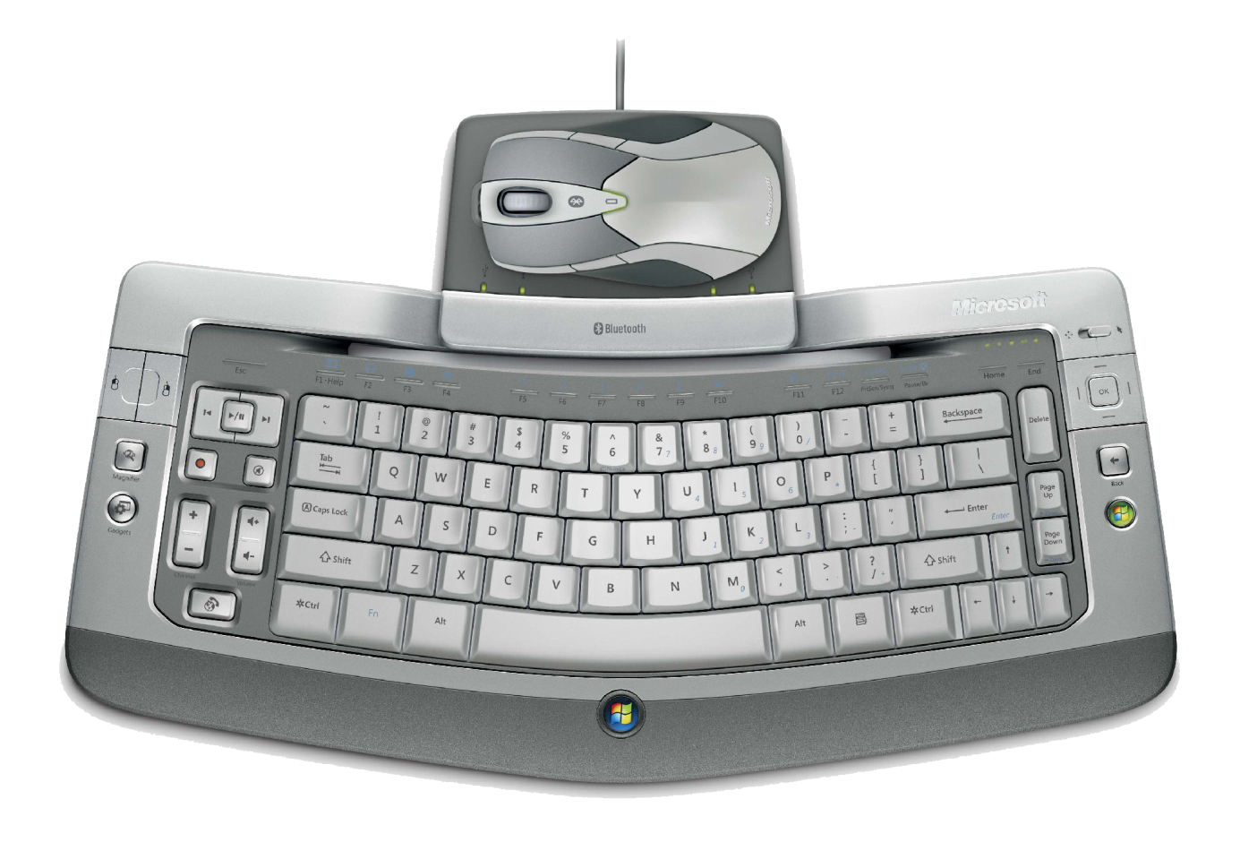
Win a Wireless Entertainment Desktop 8000!
Required Slide
Complete your evaluation and enter to win!

Slide 29



Submit an Entry Form at the BB&D Stand and Win*! A Dell Netbook valued at R4,000
* Terms & conditions apply

Slide 30



Win an Xbox 360 with DVT!
Required Slide
Be a winner with DVT
Enter your details at the DVT stand and you could WIN an XBOX 360 ARCADE!

Slide 31
Questions and Answers
<questions/>
Slides are available on my blog @ http://www.rudigrobler.net/speaking

Slide 32

© 2010 Microsoft Corporation. All rights reserved. Microsoft, Windows, Windows Vista and other product names are or may be registered trademarks and/or trademarks in the U.S. and/or other countries.
The information herein is for informational purposes only and represents the current view of Microsoft Corporation as of the date of this presentation. Because Microsoft must respond to changing market conditions, it should not be interpreted to be a commitment on the part of Microsoft, and Microsoft cannot guarantee the accuracy of any information provided after the date of this presentation. MICROSOFT MAKES NO WARRANTIES, EXPRESS, IMPLIED OR STATUTORY, AS TO THE INFORMATION IN THIS PRESENTATION.

